Slide 1
CS 401 – ARTIFICIAL INTELLIGENCE
LECTURE 10: INFORMED SEARCH STRATEGIES

Slide 2
Introduction
Difference between informed and uninformed search strategy

Slide 3
HEURISTIC SEARCH
Heuristics: Rules for choosing the branches in a state space that are most likely to lead to an acceptable problem solution.
Used when:
computational costs are high

Slide 4
Greedy best first search
Evaluation function
Map example
Arad to Bucharest (proves that the algo is not optimal)
Iasi to Fragaras (proves that algo is not complete)

Slide 5
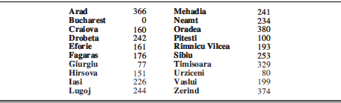
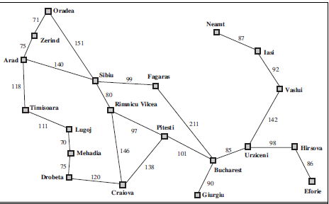

Slide 6
A* search algorithm
F(n)= g(n) + h(n)
G(n): cost from initial state to n
H(n): estimate cost to reach from n to goal
Arad to Bucharest example

Slide 7
Conditions for optimality
H(n) value less than true cost to goal ----admissible property
h(n) ≤ c(n, a, n’) + h(n’) --- consistency property

